Slide 1
Researching, MLA Formatting, and Citations

Slide 2
Researching: The Basics
Research should provide you with facts and evidence to support your ideas
Successful research depends on:
Understanding the differences between types of information.
Knowing how to evaluate information.
Knowing efficient ways to retrieve information.

Slide 3
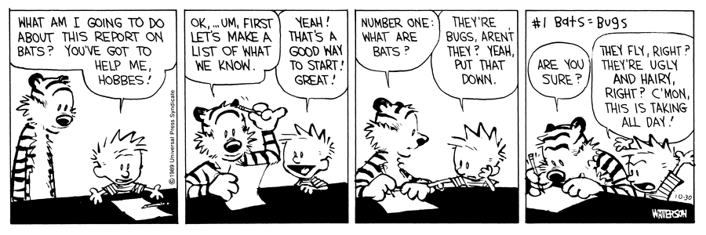
Starting Research
Brainstorm what you already know and what you want to find out
Choose a topic that interests you
Identify the main concepts of the topic
Review the assignment’s research requirements. How many? What types?

Slide 4
Types of Sources for Research
Primary Source
Secondary Source
Book
Academic Journal
Newspaper
Websites
Multimedia
Blogs
Online v. Print sources

Slide 5
Selecting Good Sources
Choosing good sources is essential for your project!
The Internet is great but you have to be careful!
Some basic questions:
Who is the author? Qualifications?
What organizations published it?
When was it written?
Type of website and who funds it? .com? .gov? .org? .edu?
The following slides are from: http://www.lib.berkeley.edu/TeachingLib/Guides/Internet/Evaluate.html

Slide 6
1. What can a URL tell you?
1. Before you leave the list of search results -- before you click and get interested in anything written on the page -- glean all you can from the URLs of each page.
2. Then choose pages most likely to be reliable and authentic.
Questions to ask:
Is it somebody's personal page? Read the URL carefully
What type of domain does it come from ? (educational, nonprofit, commercial, government, etc.)
Is it published by an entity that makes sense?
Notes:
Is it somebody's personal page? Read the URL carefully:
Look for a personal name (e.g., jbarker or barker) following a tilde ( ~ ), a percent sign ( % ), or or the words "users," "members," or "people."
Is the server a commercial ISP or other provider of web page hosting (like aol.com or geocities.com)
Personal pages are not necessarily "bad," but you need to investigate the author carefully. For personal pages, there is no publisher or domain owner vouching for the information in the page.
What type of domain does it come from ? (educational, nonprofit, commercial, government, etc.) Is the domain extension appropriate for the content?
Government sites: look for .gov, .mil
Educational sites: look for .edu (Note that this can include personal student and faculty pages as well as official college and university pages)
Nonprofit organizations: look for .org (Note that this is no longer restricted to nonprofits)
Many country codes, such as .us, .uk. and .de, are no longer tightly controlled and may be misused. Look at the country code, but also use the techniques in sections 2 and 4 below to see who published the web page.
Look for appropriateness. What kind of information source do you think is most reliable for your topic?
Is it published by an entity that makes sense? Who "published" the page? In general, the publisher is the agency or person operating the "server" computer from which the document is issued.
The server is usually named in first portion of the URL (between http:// and the first /)
Have you heard of this entity before?
Does it correspond to the name of the site?
You can rely more on information that is published by the source:
Look for New York Times news from www.nytimes.com
Look for health information from any of the agencies of the National Institute of Health on sites with nih somewhere in the domain name.

Slide 7
2. Scan the perimeter of the page, looking for answers to these questions:
Look for links that say "About us," "Philosophy," "Background," "Biography", etc.
If you cannot find any links like these, you can often find this kind of information if you Truncate back the URL.
Look for the date "last updated" - usually at the bottom of a web page.
Questions to ask:
Who wrote the page?
Is the page dated? Is it current enough?
What are the author's credentials on this subject?
Notes:
Who wrote the page? Look for the name of the author, or the name of the organization, institution, agency, or whatever who is responsible for the page
An e-mail contact is not enough
If there is no personal author, look for an agency or organization that claims responsibility for the page.
If you cannot find this, locate the publisher by truncating back the URL (see technique above). Does this publisher claim responsibility for the content? Does it explain why the page exists in any way?
Web pages are created with a purpose in mind by some person or agency or entity. You are looking for someone who claims accountability and responsibility for the content. An e-mail address with no additional information about the author is not sufficient for assessing the author's credentials. If this is all you have, try emailing the author and asking politely for more information about him/her.
Is the page dated? Is it current enough? Is it "stale" or "dusty" information on a time-sensitive or evolving topic?
CAUTION: Undated factual or statistical information is no better than anonymous information. Don't use it without confirmation.
How recent the date needs to be depends on your needs. For some topics you want current information. For others, you want information put on the web near the time it became known. In some cases, the importance of the date is to tell you whether the page author is still maintaining an interest in the page, or has abandoned it.
What are the author's credentials on this subject? Does the purported background or education look like someone who is qualified to write on this topic?
Might the page be by a hobbyist, self-proclaimed expert, or enthusiast?
Is the page merely an opinion? Is there any reason you should believe its content more than any other page?
Is the page a rant, an extreme view, possibly distorted or exaggerated?
If you cannot find strong, relevant credentials, look very closely at documentation of sources (next section).
Anyone can put anything on the web for pennies in just a few minutes. Your task is to distinguish between the reliable and questionable. Many web pages are opinion pieces offered in a vast public forum. You should hold the author to the same degree of credentials, authority, and documentation that you would expect from something published in a reputable print resource (book, journal article, good newspaper).

Slide 8
3. Look for indicators of quality information
Look for a link called "links," "additional sites," "related links," etc.
In the text, if you see little footnote numbers or links that might refer to documentation, take the time to explore them.
Look at the publisher of the page (first part of the URL).
Questions to ask:
Are sources documented with footnotes or links?
If reproduced information (from another source), is it complete, not altered, not fake or forged?
Are there links to other resources on the topic?
Notes:
Are sources documented with footnotes or links? Where did the author get the information?
As in published scholarly/academic journals and books, you should expect documentation.
If there are links to other pages as sources, are they to reliable sources?
Do the links work?
In scholarly/research work, the credibility of most writings is proven through footnote documentation or other means of revealing the sources of information. Saying what you believe without documentation is not much better than just expressing an opinion or a point of view. What credibility does your research need? An exception can be journalism from highly reputable newspapers. But these are not scholarly. Check with your instructor before using this type of material. Links that don't work, or that lead to other weak or fringe pages, do not help strengthen the credibility of your research.
If reproduced information (from another source), is it complete, not altered, not fake or forged? Is it retyped? If so, it could easily be altered.
Is it reproduced from another publication?
Are permissions to reproduce and copyright information provided?
Is there a reason there are not links to the original source if it is online (instead of reproducing it)?
You may have to find the original to be sure a copy of something is not altered and is complete. Look at the URL: is it from the original source? If you find a legitimate article from a reputable journal or other publication, it should be accompanied by the copyright statement and/or permission to reprint. If it is not, be suspicious. Try to find the source. If the URL of the document is not to the original source, it is likely that it is illegally reproduced, and the text could be altered, even with the copyright information present.
Are there links to other resources on the topic? Are the links well chosen, well organized, and/or evaluated/annotated?
Do the links work?
Do the links represent other viewpoints?
Do the links (or absence of other viewpoints) indicate a bias?
Many well developed pages offer links to other pages on the same topic that they consider worthwhile. Pages that offer opposing viewpoints as well as their own are more likely to be balanced and unbiased than pages that offer only one view. Anything not said that would be said if all points of view were represented? Always look for bias in text and links, especially when you agree with what's being said.

Slide 9
4. What do others say?
Find out what other web pages link to this page.
Look up the author's name in Google or Yahoo!
Questions to Ask:
Who links to the page?
What do others say about the author or responsible authoring body?

Slide 10
5. Does it all add up?
1. Step back and think about all you have learned about the page. Listen to your gut reaction. Think about why the page was created, the intentions of its author(s). If you have doubts, ask your instructor or go to the library reference desks and ask for advice.
2. Be sensitive to the possibility that you are the victim of irony, spoof, fraud, or other falsehood.
3. Ask yourself if the web is truly the best place to find resources for the research you are doing.
Questions to Ask:
Why was the page put on the web?
Might it be ironic? Satire or parody?
Is this as credible and useful as the resources (books, journal articles, etc.) available in print or online through the library?
Notes:
Why was the page put on the web? Inform, give facts, give data?
Explain, persuade?
Sell, entice?
Share?
Disclose?
These are some of the reasons to think of. The web is a public place, open to all. You need to be aware of the entire range of human possibilities of intentions behind web pages. Might it be ironic? Satire or parody? Think about the "tone" of the page.
Humorous? Parody? Exaggerated? Overblown arguments?
Outrageous photographs or juxtaposition of unlikely images?
Arguing a viewpoint with examples that suggest that what is argued is ultimately not possible.
It is easy to be fooled, and this can make you look foolish in turn. Is this as credible and useful as the resources (books, journal articles, etc.) available in print or online through the library? Are you being completely fair? Too harsh? Totally objective? Requiring the same degree of "proof" you would from a print publication?
Is the site good for some things and not for others?
Are your hopes biasing your interpretation?
What is your requirement (or your instructor's requirement) for the quality of reliability of your information? In general, published information is considered more reliable than what is on the web. But many, many reputable agencies and publishers make great stuff available by "publishing" it on the web. This applies to most governments, most institutions and societies, many publishing houses and news sources. But take the time to check it out.

Slide 11
Wikipedia…To Use or Not to Use?
The general consensus…. No!
But…Wikipedia can still be useful to help your research!
Use the footnotes/sources to do your own research and determine creditability.

Slide 12
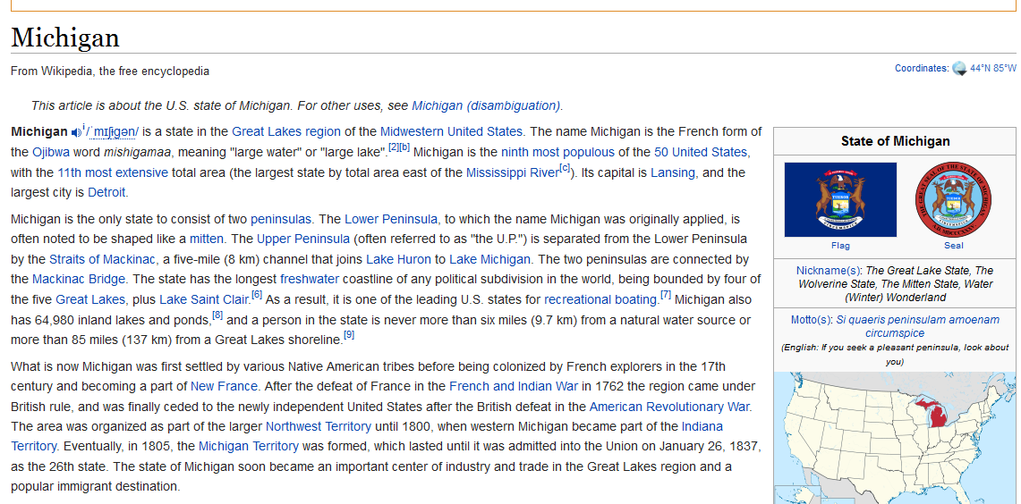
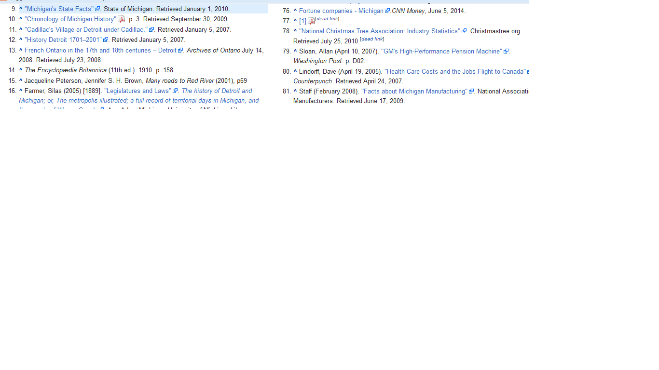
Footnote

Slide 13
And now you have a quality source!

Slide 14
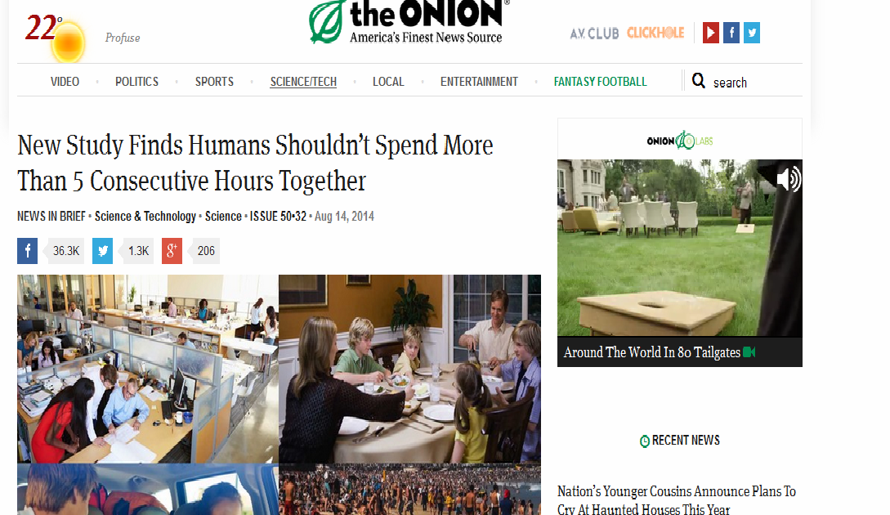
Evaluate this source! Good or Bad?

Slide 15
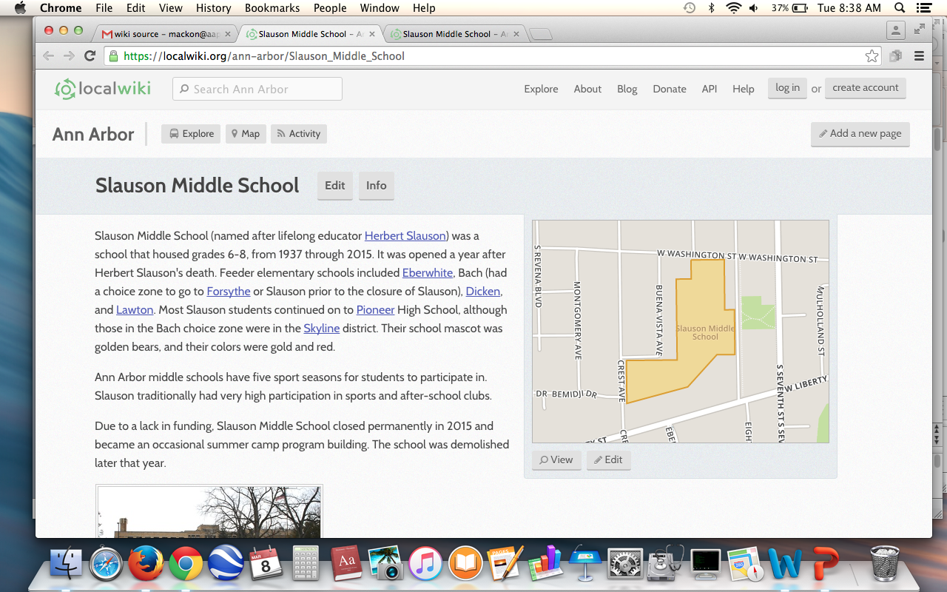
Evaluate the source! Good or bad?

Slide 16
Understanding Fact vs. Opinion
When researching, you have to distinguish between facts and opinions.
Facts cannot be argued! Ex- The earth is round.
Opinions can be argued! Ex- Chocolate is the best ice cream flavor

Slide 17
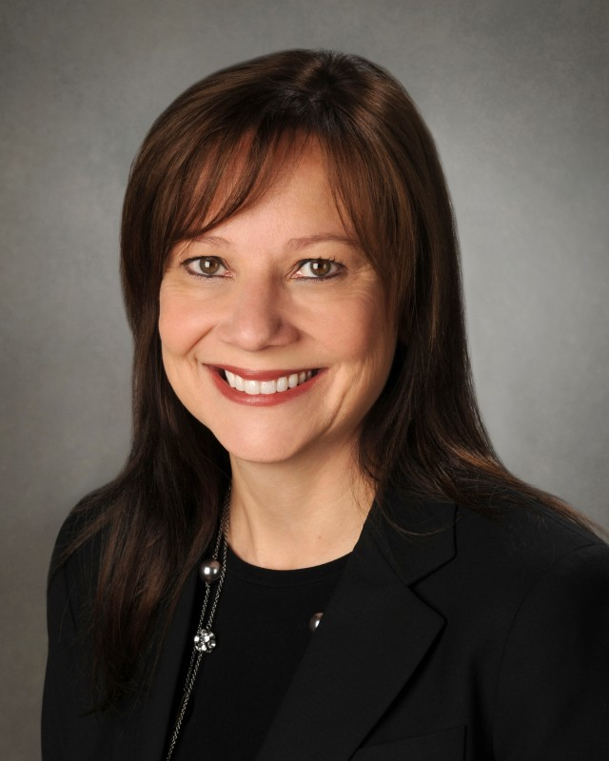
Fact or Opinion?
"On Tuesday, Ms. [Mary] Barra, 51, completed a remarkable personal odyssey when she was named as the next chief executive of G.M.--and the first woman to ascend to the top job at a major auto company."

Slide 18
Fact or Opinion?
"A big reason America is falling behind other countries in science and math is that we have effectively written off a huge chunk of our population as uninterested in those fields or incapable of succeeding in them."

Slide 19
Fact or Opinion?
"Instead of striving to make work fun, managers should concentrate on creating the conditions in which a variety of personality types, from the excitable to the naturally downbeat, can flourish."

Slide 20
Fact or Opinion?
"In the first step to formally eradicating a thrilling but dangerous staple of the game — and an emphatic response to the concussion crisis that has gripped other sports — Major League Baseball’s rules committee voted Wednesday to eliminate home-plate collisions."

Slide 21
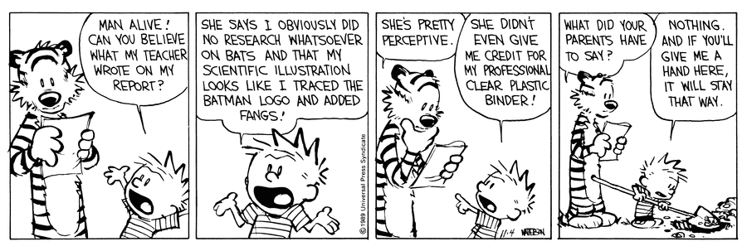
Don’t be like Calvin. Do your research and do it well!

Slide 22
MLA Formatting
12 point font (Arial or Times New Roman)
Double spaced
1 inch margins
Header with last name and page number in right corner
Title centered and same font size as text
In left hand corner:
Name
Teacher’s name
Class (Name and period)
Date (Day Month Year)

Slide 23
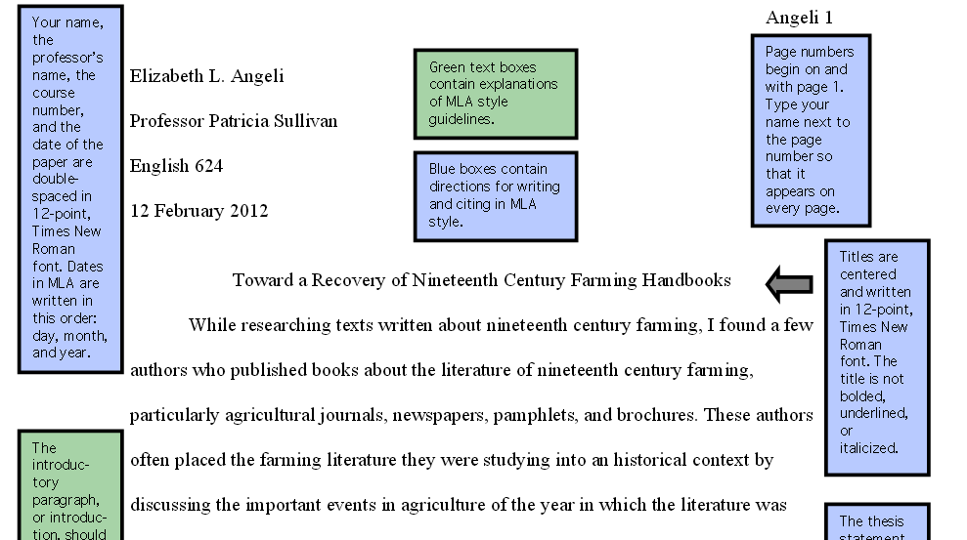
Sample MLA Format

Slide 24
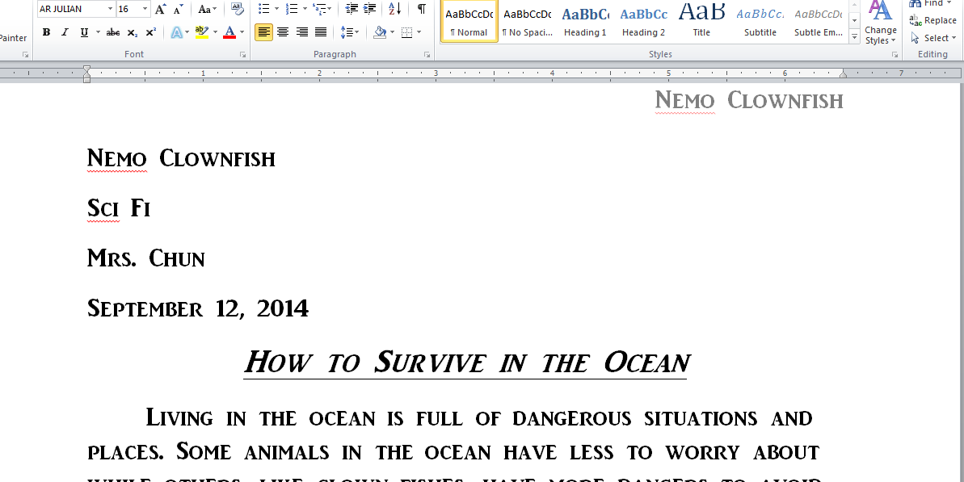
Help Nemo fix his paper!

Slide 25
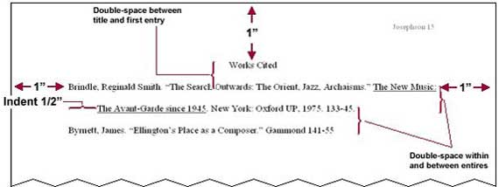
Work Cited-MLA Format

Slide 26
Work Cited Tools
You can use these websites but you should still verify that the information is correctly done
www.easybib.com
www.citationmachine.net
www.bibme.org
http://www.calvin.edu/library/knightcite/

Slide 27
MLA Citations
You should use citations throughout your research paper.
You must give credit where credit is due!
Basic citation rules
Cite anything with statistics and numbers
Cite anything that was not your original idea
You do not have to cite common knowledge
“The Earth is round”

Slide 28
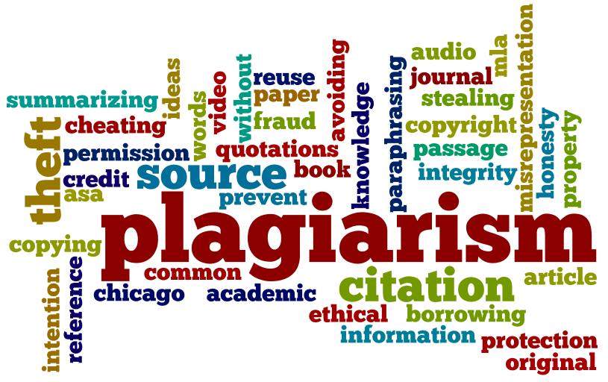
Why use citations?
If you do not use citations, you are plagiarizing! Don’t steal other people’s ideas or hard work!
Citations help legitimize your ideas
No citations= No credit
for many assignments

Slide 29
In-Text Citations
MLA in-text citations- Parenthetical Citations
Author-page method
One author
Wordsworth stated that Romantic poetry was marked by a "spontaneous overflow of powerful feelings" (263). Romantic poetry is characterized by the "spontaneous overflow of powerful feelings" (Wordsworth 263).

Slide 30
In-Text Citation
Corporate authors
Use the corporation as author-shorten if possible
No known author
We see so many global warming hotspots in North America likely because this region has "more readily accessible climatic data and more comprehensive programs to monitor and study environmental change . . ." ("Impact of Global Warming" 6).
Refers to this citation
"The Impact of Global Warming in North America." Global Warming: Early Signs. 1999. Web. 23 Mar. 2009.

Slide 31
In-Text Citations
Authors with same last names
Although some medical ethicists claim that cloning will lead to designer children (R. Miller 12), others note that the advantages for medical research outweigh this consideration (A. Miller 46).
Multiple Authors (3 or less)
Smith, Yang, and Moore argue that tougher gun control is not needed in the United States (76).
The authors state "Tighter gun control in the United States erodes Second Amendment rights" (Smith, Yang, and Moore 76).

Slide 32
In-Text Citations
Multiple authors (3 or more)
Jones et al. counter Smith, Yang, and Moore's argument by noting that the current spike in gun violence in America compels law makers to adjust gun laws (4).
Or
Legal experts counter Smith, Yang, and Moore's argument by noting that the current spike in gun violence in America compels law makers to adjust gun laws (Jones et al. 4).
Or
Jones, Driscoll, Ackerson, and Bell counter Smith, Yang, and Moore's argument by noting that the current spike in gun violence in America compels law makers to adjust gun laws (4).

Slide 33
In-Text Citations
Indirect Quotes
Ravitch argues that high schools are pressured to act as "social service centers, and they don't do that well" (qtd. in Weisman 259).
Most savvy researcher will go to the original source and quote that instead

Slide 34
Electronic and Internet Citations
Include in the citation the FIRST word that appears in the work cited
You don’t need to include a page number if no page numbers exist (no print preview is needed). If desired, use page number 1
Do not include URLs in your text. If needed, shorten!
http://www.cnn.com cnn.com

Slide 35
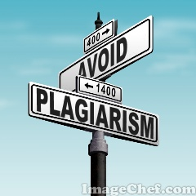
Plagiarism and Citations
It’s important to do citations correctly to avoid “accidental” plagiarism
Basic rules:
If the words in your paper are exactly the same, it must be in quotation marks.
If you are paraphrasing and it is greatly different (more of a general summary of the idea), no quotation marks but it still must be cited with parenthetical citations

Slide 36
Plagiarism or Appropriate Use?
Original Text | Student’s Paper
Adult criminals and youth involved in illegal activities have reported that guns are not difficult to obtain. Illegal or unregulated transactions are the primary sources of guns used in violent acts; stealing, borrowing from friends or acquaintances, and illegal purchasing of guns are the most common. Less than 1 in 5 guns used for illegal activities were purchased from licensed dealers. Source: Page, Randy M. and Hammermeister, Jon. “Weapon Carrying and Youth Violence.” Adolescence 32.127 (1997): 505-513. | According to Page and Hammermeister, adults and youth involved in criminal activity have reported that guns are easy to obtain. Illegal transactions are the main source of guns used in violence. Stealing, borrowing from friends, and illegal purchasing are the most common. Less than 1 in 5 guns used for illegal activities were bought from licensed dealers No work cited page

Slide 37
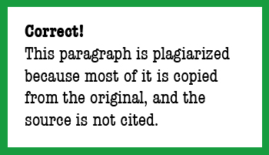
It’s plagiarism!

Slide 38
Plagiarism or Appropriate Use?
Original Text | Student’s Paper
It is not difficult to see tomorrow's sophisticated computers rapidly processing complex data from animals and transmitting it in a useful form to humans via an earpiece, handheld device, or spectacle-lens display. Similarly, computers are likely to be able to translate messages from humans into stimuli that suit the cognitive style of the intended animal recipient. Source: Lloyd, Bruce and Susan Clayton. "Doctor Dolittle for Real? Raising Questions About Interspecies Communications." The Futurist March/April 2004: 40-43. | In the future, will humans communicate with animals? Lloyd and Clayton theorize that the super computers of tomorrow will be able to transmit comprehensible information from animals to humans through small devices such as ear pieces. According to their theory, not only will animals talk to us, but we will talk back by using computers to translate our speech into "stimuli that suit the cognitive style of the intended animal recipient" (42). Lloyd, Bruce and Susan Clayton. "Doctor Dolittle for Real? Raising Questions About Interspecies Communications." The Futurist March/April 2004: 40-43. Print.

Slide 39
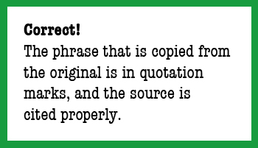
It’s Appropriate Use!

Slide 40
Plagiarism or Appropriate Use?
Original Text | Student’s Paper on Violence in Video Games
The phenomenon of extremely violent video games is a dubious leap forward in the ability to mainline violence into the minds and lives of young people. Players of violent video games are not simply passive viewers of realistically depicted violence. They instead become the glorified, gun-in-hand, on-screen perpetrators of murder and other criminal acts. Source: Worthy, Kym. "Why Violent Video Games May Be Worse Than Other Media Violence." Michigan Chronicle 5 Oct. 2005: A1. | Worthy claims that players of violent video games are not simply passive viewers of realistically depicted violence. They instead become the glorified, gun-in-hand, on-screen perpetrators of murder and other criminal acts. Worthy, Kym. "Why Violent Video Games May Be Worse Than Other Media Violence." Michigan Chronicle 5 Oct. 2005: A1. Print.

Slide 41
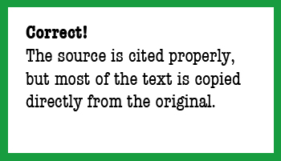
It’s Plagiarism!
The previous three samples came from: https://www.libraries.psu.edu/psul/lls/students/plagiarism_quiz.html

Slide 42
How often should you cite?
While citing is good, too many citations can hurt your paper because your own ideas are not strong.
Questions to ask:
Did I provide adequate commentary on the cited material?
Did I begin and end my paragraphs in my own voice?
Have I used the cited material to support my specific thesis?
Have I relied too heavily on one source?
Have I included too many direct quotations?
http://writingcenter.waldenu.edu/33.htm
Notes:
1. Did I provide adequate commentary on the cited material?
Remember that the cited material should illustrate rather than substitute for your point. Make sure your paper is more than a collection of ideas from your sources; it should provide an original interpretation of that material. For help with creating this commentary while also avoiding personal opinion, see our Commentary vs. Opinion resource.
2. Did I begin and end my paragraphs in my own voice?
The opening sentence of each paragraph should be your topic sentence, and the final sentence in the paragraph should conclude your point and lead into the next. Without these aspects, you leave your reader without a sense of the paragraph's main purpose. Additionally, the reader may not understand your reasons for including that material. 3. Have I used the cited material to support my specific thesis?
All material that you cite should contribute to your main argument (also called a thesis or purpose statement). When reading the literature, keep that argument in mind, noting ideas or research that speaks specifically to the issues in your particular study. See our synthesis demonstration for help learning how to use the literature in this way. 4. Have I relied too heavily on one source?
Most research papers should include a variety of sources from the last 3-5 years. You may find one particularly useful study, but try to balance your references to that study with research from other authors. Otherwise, your paper becomes a book report on that one source and lacks richness of theoretical perspective. 5. Have I included too many direct quotations?
Direct quotations are best avoided whenever possible. While direct quotations can be useful for illustrating a rhetorical choice of your author, in most other cases paraphrasing the material is more appropriate. Using your own words by paraphrasing will better demonstrate your understanding and will allow you to emphasize the ways in which the ideas contribute to your paper's main argument. - See more at: http://writingcenter.waldenu.edu/33.htm#sthash.ZmhvdwMl.dpuf

Slide 43
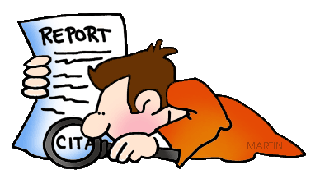
Remember…..
When in doubt, cite your research!

Slide 44
Other Resources Used
http://www.nova.edu/library/help/tutorials/basics.html
https://owl.english.purdue.edu/
http://www.lib.berkeley.edu/TeachingLib/Guides/Internet/Evaluate.html
http://writingcenter.waldenu.edu/33.htm
https://www.libraries.psu.edu/psul/lls/students/plagiarism_quiz.html
https://owl.english.purdue.edu/owl/resource/747/02/

