Slide 1
IMPROVED!
NEW!
Propaganda!
A MUST
SEE!
Everybody is doing it!

Slide 2
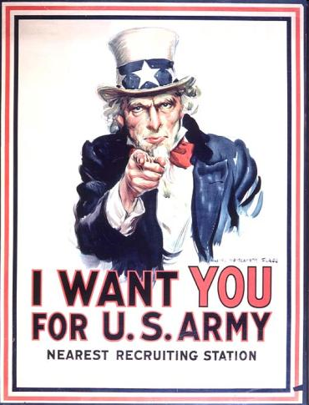
What do these images have in common?
They are all used to influence you to do something.
They are all examples of propaganda!

Slide 3
WHAT?
A message used to persuade you to believe something or do something
Propaganda
WHY?
To persuade you to buy something, think something, or do something.
WHO?
Corporations
Government
Individuals
WHERE?
Commercials Packaging Speeches Stores Billboards Internet Newspapers Everywhere!
HOW?
There are 7 propaganda techniques we will learn

Slide 4
The 1st type of Propaganda is…
Bandwagon
Persuading people to do something by letting them know others are doing it.
All the
cool kids
are doing it
Everybody
has one!

Slide 5
Bandwagon works because it makes you think “everyone is doing it” and you should too.
Why is this sign considered BANDWAGON?

Slide 6
What other examples of BANDWAGON can you think of?
From today:
From World War I:
https://www.youtube.com/watch?v=6dQRCOEeHaY

Slide 7
The 2nd type of Propaganda is…
Loaded Words
Love
Hate
Using words that will make people feel strongly about someone or something.

Slide 8
Loaded words work because they make you feel a certain way.
What words are used in these ads that make us feel a certain way?

Slide 9
What are some other examples of LOADED WORD propaganda?
https://www.youtube.com/watch?v=SKL254Y_jtc

Slide 10
The 3rd type of Propaganda is…
Testimonial
Using words and images of a famous person or an expert to persuade.

Slide 11
Testimonials work because you feel like you can trust the words of an expert or someone famous.

Slide 12
What are some other examples of TESTIMONIAL propaganda?
From today:
From the 1950s:
See Coldplay’s iTunes ad here.

Slide 13
The 4th type of Propaganda is…
Transfer
Using images to bring up strong feelings or emotions in order to persuade.

Slide 14
Transfer works because you transfer the happy feelings you associate with a picture to happy feelings about a person or product.
(This can also work with bad feelings)
What emotion is being transferred in this ad?

Slide 15
What are some other examples of TRANSFER propaganda?
https://www.youtube.com/watch?v=lqT_dPApj9U

Slide 16
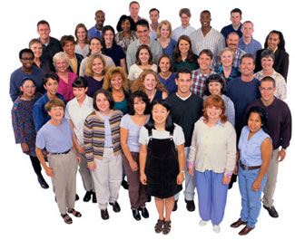
The 5th type of Propaganda is…
Plain Folks
Trying to show that a person or product is good for ordinary people because they understand people “just like you”.

Slide 17
What are some other examples of Plain Folks propaganda?
https://www.youtube.com/watch?v=LIZW5trdE5o

Slide 18
The 6th type of Propaganda is…
Name-Calling
Links a person, idea, or product to a negative symbol.

Slide 19
Name-calling works because if we believe the competition is bad, we can assume this product will be the best choice.
Why do you think we see this technique used so often in politics?

Slide 20
What are some other examples of NAME-CALLING propaganda?
https://www.youtube.com/watch?v=Q5qZedMTkkE
https://www.youtube.com/watch?v=BpOvzGiheOM

Slide 21
The 7th type of Propaganda is…
Fear
Plays on our deep-seated fears and warns the audience that disaster will strike if we do not follow the instructions.

Slide 22
Fear works because we want to keep ourselves and our family safe.

Slide 23
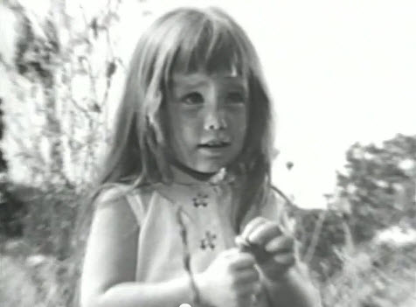
What are some other examples of FEAR propaganda?
https://www.youtube.com/watch?v=dDTBnsqxZ3k

Slide 24
What Were Those Techniques, Again?
Bandwagon
Loaded Words
Testimonial
Transfer
Plain Folks
Name-Calling
Fear

